Slide 1
Introduction to Wait Types and Response Time Analysis
Janis Griffin
Senior DBA & Sales Engineer

Slide 2
Who Am I?
Senior DBA for Solarwinds (formally Confio)
JanisGriffin@confio.com
@DoBoutAnything
Current - 25+ Years in SQL Server, Sybase, Oracle
Former – Database Design & Implementation
Specialize in performance tuning
Review database performance for customers and prospects
Common thread – How do I tune it?

Slide 3
Agenda
Response Time Analysis ( wait time methodology)
Dynamic Management Views
What are Wait Types?
Compliant Tools
Case Studies
Poor Code Design
Locking Problem
Network Issue
High CPU Usage
Q&A

Slide 4
Working on the Right Problems?
Before we start, do you know…
The most important problem in your database?
Did your vendor really fix your problem in their new patch?
If I add this index, will it really improve performance?
Which database bottlenecks are directly impacting end users?
What resources are your queries using up or waiting on?

Slide 5
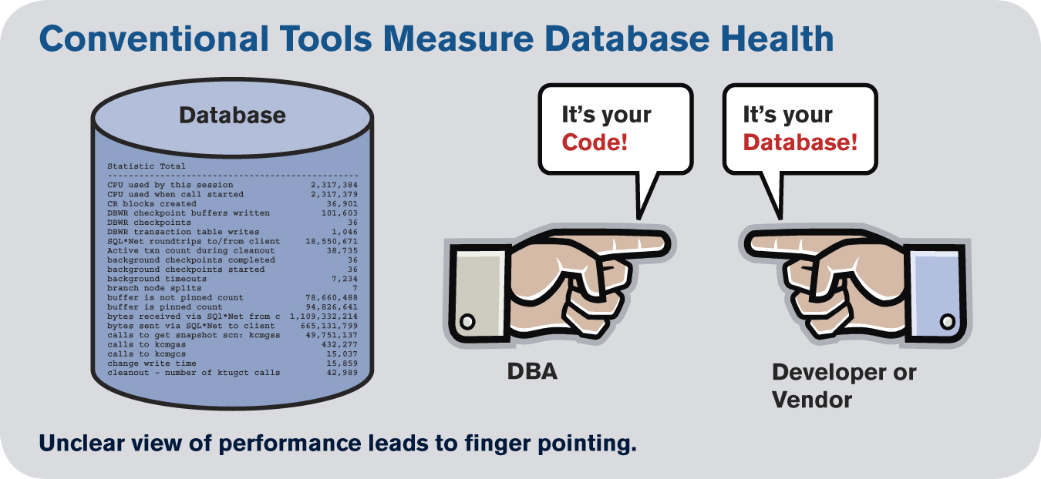
Wait Time Tuning vs. Ratios

Slide 6
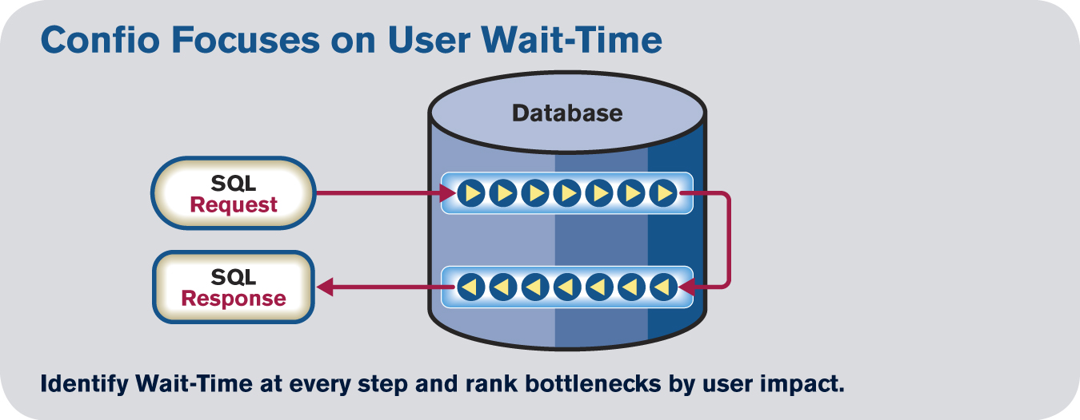
Response Time Analysis (RTA)
Database processing includes hundred of steps
Understand the total time a Query spends in Database
Identify Wait Time at every step
Rank bottlenecks (wait types) by impact on end user
Focus on Response Time

Slide 7






Monsters Lurking in Your Database?

Slide 8
Grocery Store Analogy
Cashier is the CPU
Customer being checked out is “running”
Customers waiting in line are “runnable”
Customer 1 Requires Price Check
Customer 1 “waits” on “Price Check”
Customer 2 is checked out, i.e. “running”
Customer 3 is “runnable”
Price Check is Completed
Customer 1 goes to “runnable”

Slide 9
Execution Model
_{CPU 1}
_{SPID 60 – Running}
_{Waiter List}
_{SPID 52 – ASYNC_NETWORK_IO}
_{SPID 53 – OLEDB}
_{SPID 54 – PAGELATCH_IO}
_{SPID 57 – LCK_M_S}
_{SPID 59 – WRITELOG}
_{CPU 1 Queue}
_{SPID 51 – Runnable}
_{SPID 61 – Runnable}

Slide 10
Execution Model (cont.)
_{CPU 1}
_{SPID 60 – Running}
_{CPU 1}
_{SPID 60 – Running}
_{(Needs to perform IO)}
_{SPID 51 - Running}
_{Waiter List}
_{SPID 52 – ASYNC_NETWORK_IO}
_{SPID 53 – OLEDB}
_{SPID 54 – PAGELATCH_IO}
_{SPID 57 – LCK_M_S}
_{SPID 59 – WRITELOG}
_{Waiter List}
_{SPID 52 – OLEDB}
_{SPID 53 – WRITELOG}
_{SPID 54 – PAGELATCH_IO}
_{SPID 57 – LCK_M_X}
_{SPID 59 – WAITFOR}
_{SPID 60 – PAGELATCH_IO}
_{CPU 1 Queue}
_{SPID 51 – Runnable}
_{SPID 61 – Runnable}
_{CPU 1 Queue}
_{SPID 51 – Runnable}
_{SPID 61 – Runnable}
_{SPID 59 – Runnable}

Slide 11
Wait Time Tables (2005 & Up)
http://msdn.microsoft.com/en-us/library/ms188754.aspx
http://msdn.microsoft.com/en-us/library/ms188068.aspx
2014
_{sysprocesses}
_{loginame}
_{hostname}
_{programname}
_{spid}
_{dbid}
_{waittype}
_{waittime}
_{Lastwaittype}
_{waitresource}
_{sql_handle}
_{stmt_start}
_{stmt_end}
_{cmd}
_{dm_exec_sessions}
_{login_time}
_{login_name}
_{host_name}
_{program_name}
_{session_id}
_{dm_exec_requests}
_{start_time}
_{status}
_{sql_handle}
_{plan_handle}
_{start/stop offset}
_{database_id}
_{user_id}
_{blocking_session}
_{wait_type}
_{wait_time}
_{dm_os_wait_stats}
_{wait_type}
_{waiting_tasks_count}
_{wait_time_ms}
_{dm_exec_query_stats}
_{execution_count}
_{total_logical_writes}
_{total_physical_reads}
_{total_logical_reads}
_{dm_exec_query_plan}
_{query_plan}
_{dm_exec_sql_text}
_{text}

Slide 12
Problems with DMVs
Can give an overall performance view
Can find costly queries and other problems.
Contents are from instance startup
No way to tie some information to a timeframe.
Are these Query stats from today or last week?
Need to sample data periodically
Be able to go back to 3:00 pm yesterday when problem occurred.
How often and when does this query execute?

Slide 13
Sysprocesses Table
A MASTER Table Holds SQL Server Process Information
COLUMNS
loginame - Database user login
hostname - Name of workstation
programname - Name of application
spid - SQL Server process ID
dbid - ID of database currently used by process
waittype - Binary internal column, 0x0000 if not waiting
lastwaittype - Name of last or current wait type
sql_handle - Current executing batch or object
stmt_start - Starting offset of current SQL as specified
in sql_handle
stmt_end - Ending offset of current SQL as specified
in sql_handle
cmd - Command currently being executed

Slide 14
Base Monitoring Query
INSERT INTO SessionWaitInfo
SELECT r.session_id, r.sql_handle, r.statement_start_offset,
r.statement_end_offset, r.plan_handle, r.database_id,
r.blocking_session_id, r.wait_type, r.query_hash,
s.host_name, s.program_name, s.host_process_id,
s.login_name, CURRENT_TIMESTAMP cdt
FROM sys.dm_exec_requests r
INNER JOIN sys.dm_exec_sessions s ON s.session_id = r.session_id
WHERE r.status <> 'background'
AND r.command <> 'AWAITING COMMAND'
AND s.session_id > 50
AND s.session_id <> @@SPID

Slide 15
SQL Statistics Information
DM_EXEC_QUERY_STATS
SQL2005 & Up – Dynamic Management View
sql_handle
Shows statistics of plan since last compiled
execution_count
total_logical_writes
total_physical_reads
total_logical_reads
total_rows
Etc…

Slide 16
SQL Text, Cached Plan & Database Info
dm_exec_sql_text function
Accepts sql_handle
Returns current SQL Text for SPID
select * from sys.dm_exec_sql_text(0x0300050010148551490AD50093A3000001)
dm_exec_query_plan function
Accepts plan_handle
Returns cached or currently executing plan
select * from sys.dm_exec_query_plan(0x0500050010148551F057B8E01000000)
sysdatabases – Master table
Contains one row for each database
dbid (join with dbid of sysprocesses)
Name
select dbid, name from sys.databases d, sys.sysprocesses p
where d.database_id = p.dbid

Slide 17
Wait Types
Number of Wait Types Increasing
2012 – 649
2014 – 771
Wait Categories in MDW (select * from core.wait_categories)
CPU Buffer Latch Other
Backup Memory
SQLCLR Logging
Parallelism Compilation
Latch Transaction
Lock Idle
Network I/O User Waits
Buffer I/O Full Text Search

Slide 18
Sample Wait Types
WRITELOG
Waiting for a log flush to complete
LCK_M_S, LCK_M_U, LCK_M_X…
Waiting to acquire locks
ASYNC_NETWORK_IO
Waiting on network
OLEDB
Waiting on an OLE DB provider to return data
WAITFOR (idle event)
Waiting during a WAITFOR command
PAGEIOLATCH_X
Waiting for disk to memory transfers

Slide 19
RTA Compliant Tool Types
Two Primary Types of Tools – both have a place in organization
Tracing Tools
Focus on one session at a time
Traces every step of the process
High overhead, point in time data only
Examples: SQL Server Profile, Extended Events (2008+)
Be careful of session statistics skew (not viewing big picture)
Very precise – only way to get all variable information
Ideal if you know a problem is going to occur in the future
Difficult to see trends over time

Slide 20
RTA Compliant Tool Types
Two Primary Types of Tools – both have a place in organization
Continuous DB Wide Monitoring Tools
24/7 sampling provides real-time and historical perspective
Allows DBA to go back in time
I had a problem at 3:00 pm yesterday
Not the level of detail provided by tracing
Usually have trend reports to allow communication with other groups
What is starting to perform poorly?
What progress have we made while tuning?

Slide 21
Wait Time Methodology & RTA
For Key Principles of RTA
SQL View: All statistics and information at SQL statement level
Time View: Measure Time, not number of times something occurred
Full View: Measure every wait individually to isolate source of problems
Historical View: Store data long term to spot trends, anomalies, relationships and easier analytics

Slide 22
RTA – How to use it?
Proactive View
What if a User Complains
Firefighting – Drive it to ‘Root Cause’
Blocking Issue (not tuning issue)
Long Term Trends
Current (right now) Issue

Slide 23
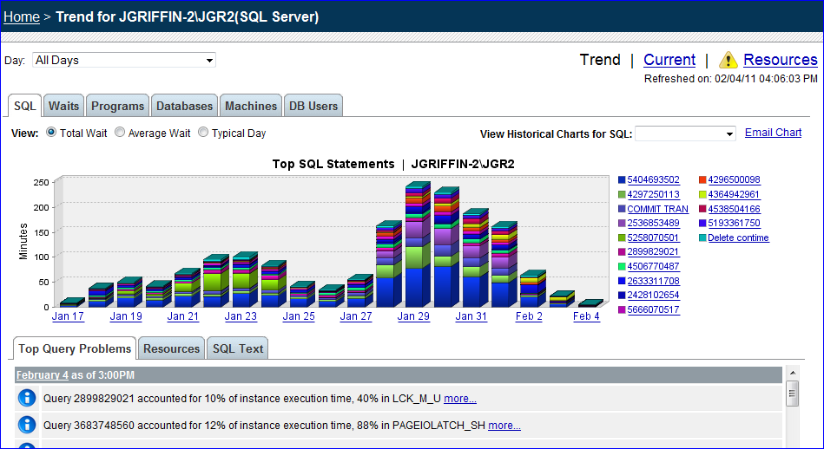
Proactive View

Slide 24
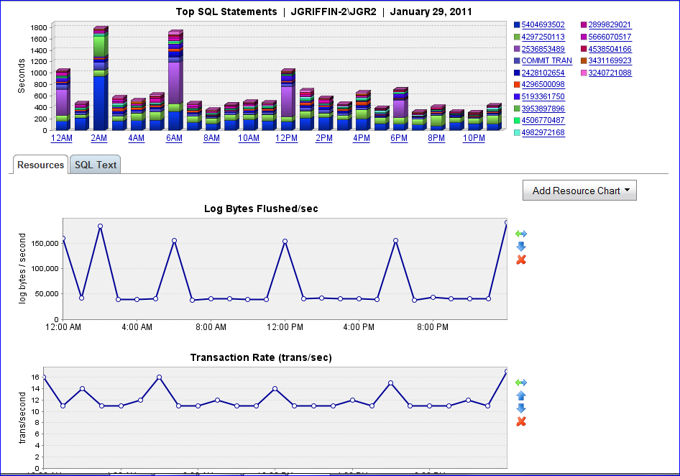
Users Complain

Slide 25
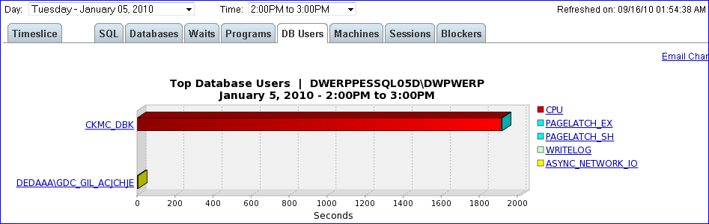
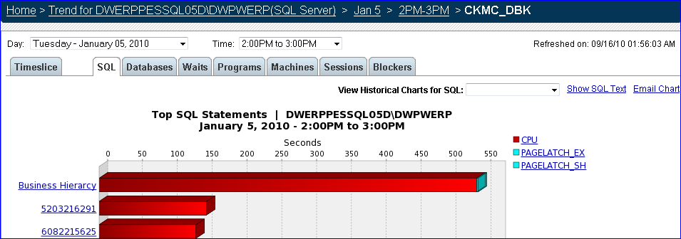
Specific User Complains

Slide 26
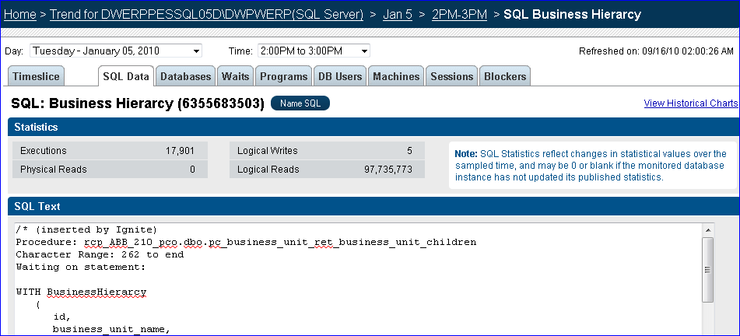
Firefighting – Driving to Root Cause

Slide 27
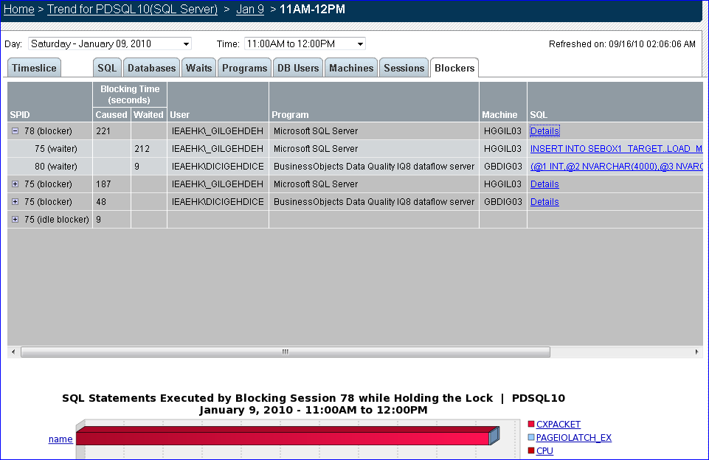
Blocking Issue

Slide 28
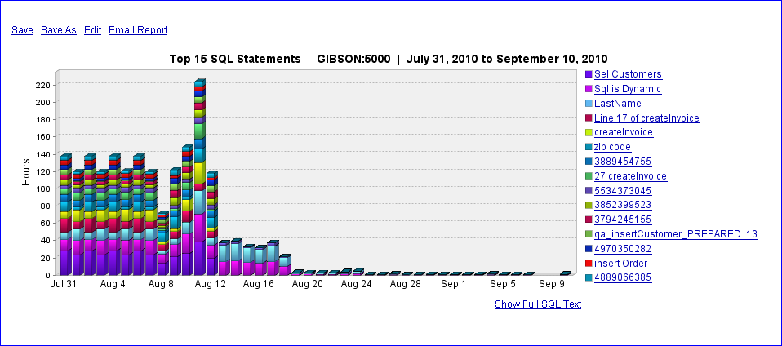
Long Term Issues, Trends & Tuning

Slide 29
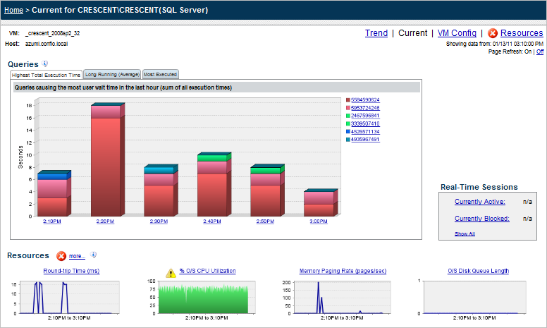
Current View

Slide 30
Case Study 1 – Poor Code Design
Problem Observed:
Situation: Developer noticed long processing times when updating data in test db
Production DBAs would not let code go to production that was taking this long
Existing database tools not giving enough information to resolve issues in a timely fashion.
Used wait time methodology & RTA to determine what the process was waiting for

Slide 31
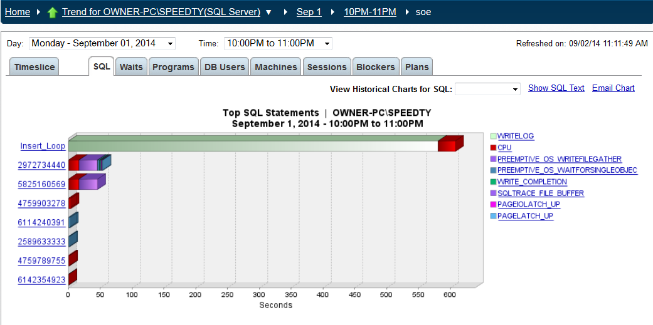
Original Problem

Slide 32
What does RTA tell us?
Which SQL: Insert_Loop
Which Wait Type: WRITELOG (96%)
How much time: 10+ Minutes

Slide 33
Code Review
Inserted 70,000 rows in 10:08
DECLARE @i INT
SET @i = 1
WHILE @i < 70000
BEGIN
BEGIN TRANSACTION
INSERT INTO [jpetstore].[dbo].[product](
[productid],
[category],
[name],
[descn])
VALUES (@i,
floor(@i / 1000),
'PROD' + REPLACE(str(@i),' ',''),
'PROD' + REPLACE(str(@i),' ',''))
SET @i = @i + 1
COMMIT
END

Slide 34
“WRITELOG” Description
Occurs while waiting for a log flush to complete.
Common operations that cause log flushes are checkpoints and transaction commits.
Solutions
Commit data less often
Add additional IO bandwidth to the disk subsystem where the transaction log is stored.
Move non-transaction log IO from the disk.
Move the transaction log to a less busy disk.
Reduce the size of the transaction log has also helped in some cases

Slide 35
Resolution
Inserted 70,000 rows in 0:28 vs. 10:08
DECLARE @i INT
SET @i = 1
BEGIN TRANSACTION
WHILE @i < 70000
BEGIN
INSERT INTO [jpetstore].[dbo].[product](
[productid],
[category],
[name],
[descn])
VALUES (@i,
floor(@i / 1000),
'PROD' + REPLACE(str(@i),' ',''),
'PROD' + REPLACE(str(@i),' ',''))
SET @i = @i + 1
END
COMMIT

Slide 36
Case Study 2 – Locking Problem
Problem Observed:
Situation: Web Application performance unsatisfactory
Database performance causing excessive delays for end users
Existing database tools not giving information to resolve issues in a timely fashion.
DBA Team concerned because escalations and finger pointing was occurring

Slide 37
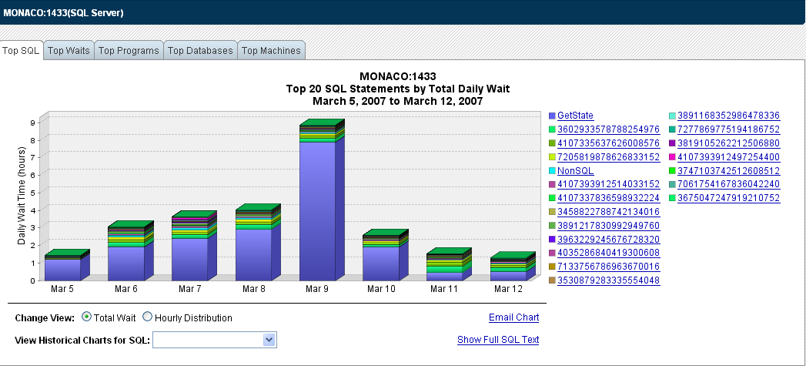
Offending SQL Statements
March 5, 2014 to March 12, 2014
GetState SQL – 8 hours
wait time

Slide 38
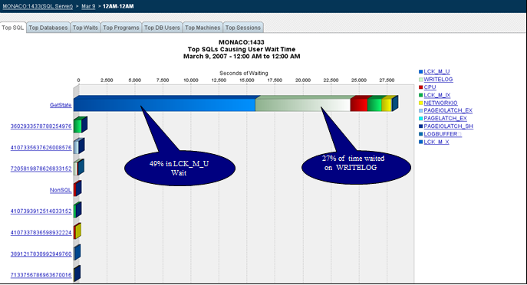
Wait Types During Problem
March 9 2014 – 12AM to ‘ 12AM

Slide 39
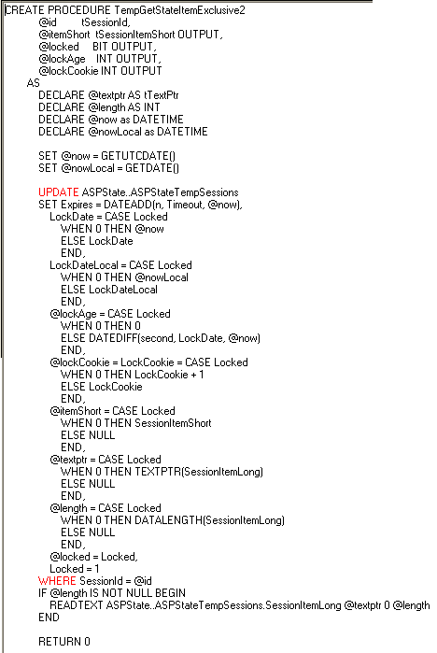
Get State Procedure

Slide 40
What does RTA tell us
Which SQL: GetState
Which Wait Type: LCK_M_U (49%)
WRITELOG (27%)
How much time: 8 Hours of wait
time per day

Slide 41
“LCK_M_U” Description
Update Lock. Normally occurs when attempting to update a row that is locked by another session.
Resolved by:
DBA's and Developer's
Solutions
For shared locks, check Isolation level for transaction. Keep transaction as short as possible.
Check for memory pressure, which causes more physical I/O, thus prolonging the duration of transactions and locks.

Slide 42
“WRITELOG” Description
Occurs while waiting for a log flush to complete.
Common operations that cause log flushes are checkpoints and transaction commits.
Solutions
Add additional IO bandwidth to the disk subsystem where the transaction log is stored.
Move non-transaction log IO from the disk.
Move the transaction log to a less busy disk.
Reduce the size of the transaction log has also helped in some cases
Commit data less often

Slide 43
Results
Found Locking & Logging Wait Problems to be 76% of the total wait time
Solutions
Deleted Obsolete Rows from Table. Reduced wait time for this procedure from 8 hours on March 9th to 30 minutes after removing the data.
Rebuilt Indexes
Resized transaction logs

Slide 44
Tuning Results Observed
March 5, 2014 to March 12, 2014

Slide 45
Case Study 3 – Network Issues
Problem Observed:
Situation: Microsoft Access application was performing very poorly
Some screens in Access took several minutes to return to the user
Access was hitting tables in SQL Server database
Access developers blamed SQL Server DBAs
Classic finger-pointing scenario

Slide 46
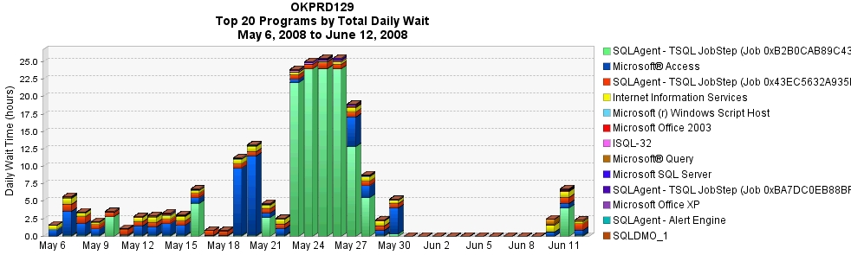
Problem Details

Slide 47
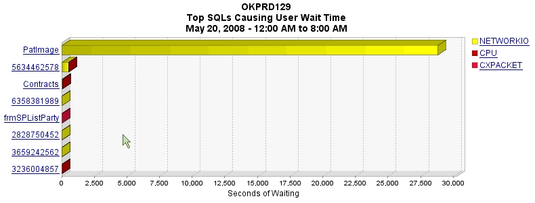
Offending SQLs

Slide 48
What does RTA tell us?
Which SQL: PatImage
Which Resource: NETWORKIO (ASYNC_NETWORK_IO)
How much time: 7.7 Hours of wait
time per day

Slide 49
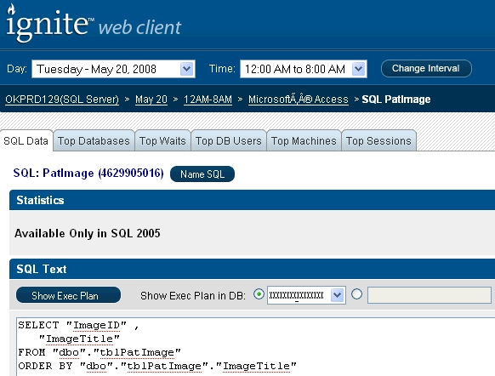
PatImage Details

Slide 50
“ASYNC_NETWORK_IO” Description
Occurs on network writes when the task is blocked behind the network. May be blocked waiting for client to receive data. Verify that the client is processing data from the server
Resolved by:
Network Administrators or Developers
Solutions:
If abnormally high, check that a component of the network isn't malfunctioning. Otherwise, may need to speed up the client to accept or process data faster.

Slide 51
Resolution
Query is waiting on ASYNC_NETWORK_IO
Call the Network Admin, Right?
Not so fast – review the query again
Query has no WHERE clause
Access was sending this query to SQL Server getting every row in the PatImage table
Access then joined it to another table queried in a similar fashion
Access did the joins instead of SQL Server

Slide 52
Case Study 4 – High CPU Usage
Problem Observed:
Situation: Encountering High CPU Usage during the day
Database performance causing excessive delays for external customer.
Existing database tools not giving enough information to resolve issues in a timely fashion.
Management wanted to purchase new server with more powerful CPUs

Slide 53
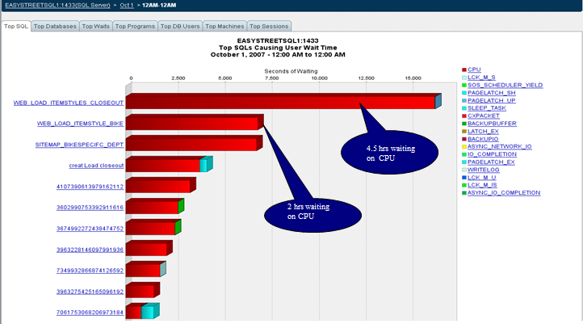
Offending SQLs

Slide 54
RTA Findings
Which SQL: WebLoad_Itemstyle
(closeout & bike sqls )
Which Resource: CPU
How much time: 6.5 Hours of wait
time per day

Slide 55
“CPU” Description
The database is typically using the CPU and/or memory (not necessarily waiting to use the CPU).
Solutions
Memory Scans Queries that have high waits on CPU may be reading more data from memory than necessary. (Full Table / Inefficient Index scans)
Try to issue fewer queries. It is also possible to cache data in the application that may require fewer queries against the database.
Check to see if other database activity, such as large batch jobs, can be scheduled for another time. These types of jobs may cause significant memory and/or CPU contention.

Slide 56
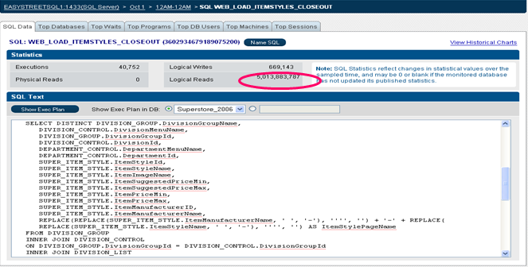
High Logical Reads

Slide 57
Results
Found CPU Usage / Wait Problem to be 100% of the total wait time.
Solutions
Review current index usage to reduce the amount of data being read in memory.
Move other batch processes that are running at same time to other timeslots when CPU not high.

Slide 58
Summary
Conventional Tuning focuses on “system health” and can lead to finger-pointing and confusion
Response Time Analysis using wait times and wait types is the best way to tune
Continuous DB-wide monitoring tool
4 Key Principles
sql, time, resource (wait type), historical views
Questions & Answers

Slide 59
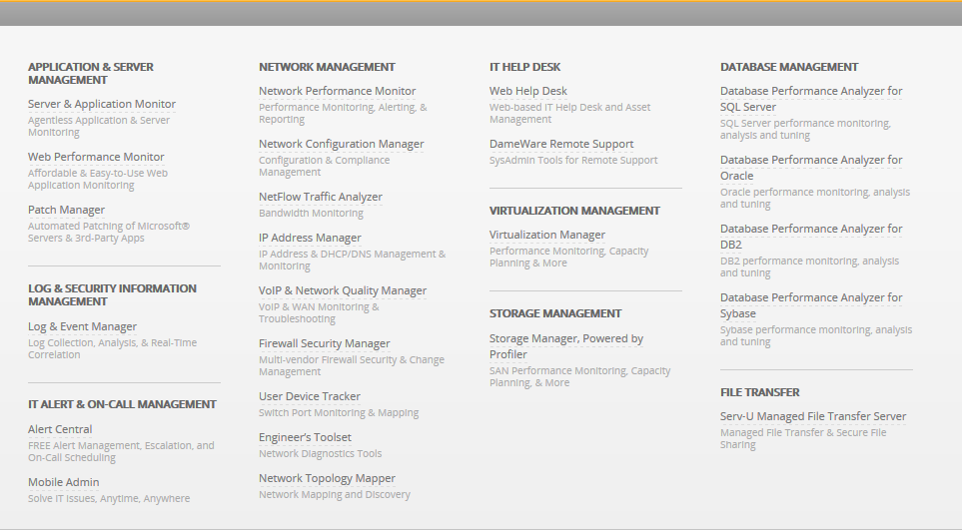
About Solarwinds

Slide 60
Thank You!
The SOLARWINDS and SOLARWINDS & Design marks are the exclusive property of SolarWinds Worldwide, LLC, are registered with the U.S. Patent and Trademark Office, and may be registered or pending registration in other countries. All other SolarWinds trademarks, service marks, and logos may be common law marks, registered or pending registration in the United States or in other countries. All other trademarks mentioned herein are used for identification purposes only and may be or are trademarks or registered trademarks of their respective companies.

